Slide 1
PROJECT 4
EXPLORATION OF THE CONJECTURE OF A PERSON’S TYPING DYNAMICS
Group 4
Sai Ram Vodnala
Carlos Quevedo Garza
Kevin Osei-Onomah
Soniya Shahi
November 2024

Slide 2

Introduction
Data Overview
Exploratory Data Analysis (EDA)
Table of Contents
Model Development and Evaluation
Post Hoc Analysis
Quantile Regression
Conclusion

Slide 3
Introduction
Problem
Objectives
Goals
Typing dynamics vary across individuals and sessions, posing challenges for consistent and reliable modeling in password-based authentication systems.
Explore temporal changes in typing dynamics and Develop models to predict typing time for the 401st repetition based on prior data.
Compare predictive models to understand typing behavior, enhance typing efficiency, and improve password-based security systems.

Slide 4

Task 1: Exploratory Data Analysis
Response Variables:
Total Time: Overall time taken to type the password
Total Hold Time: Time keys are held down
Total UD (Up-Down) Time: Time between key release and the next next key press.
Total DD (Down-Down) Time: Time between pressing consecutive keys

Slide 5
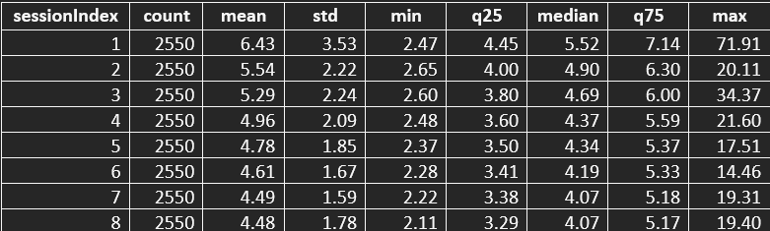
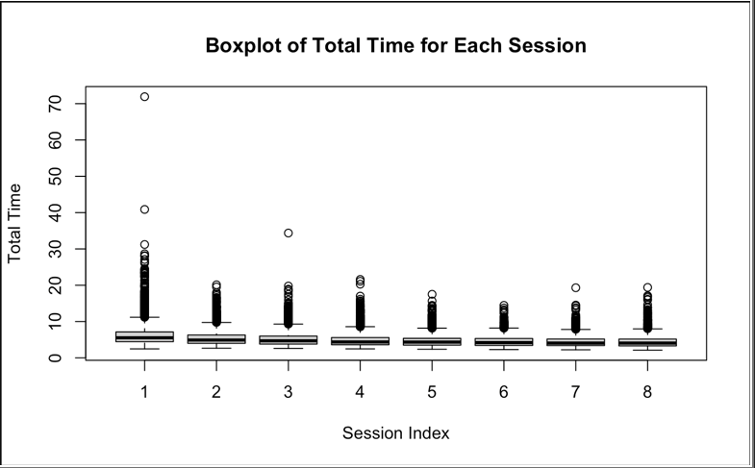
Task 1: Exploratory Data Analysis
Total Time:

Slide 6
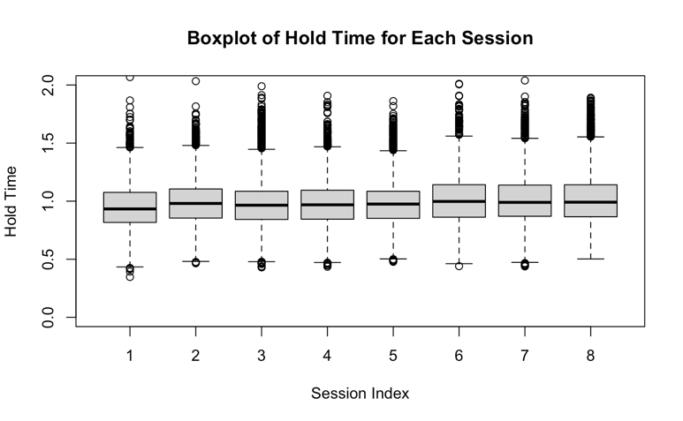
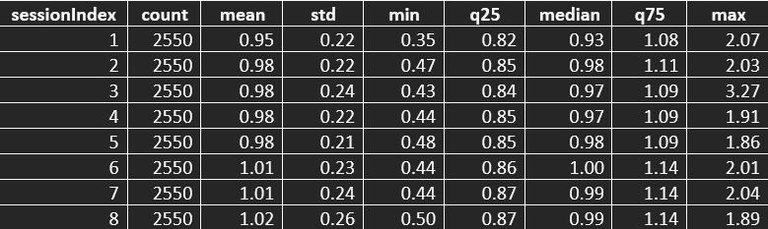
Task 1: Exploratory Data Analysis
2. Total Hold Time:

Slide 7
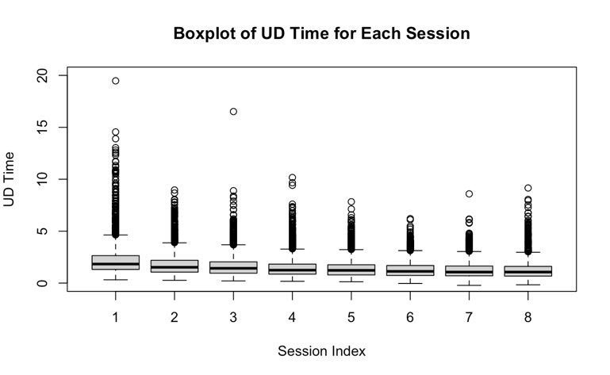
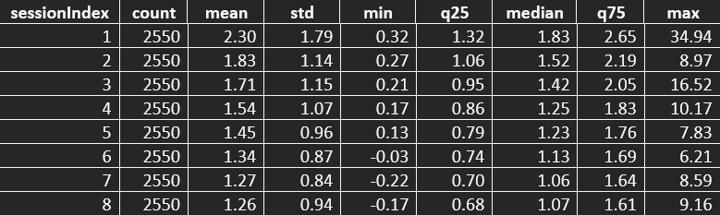
Task 1: Exploratory Data Analysis
3. Total UD (Up-Down) Time:

Slide 8
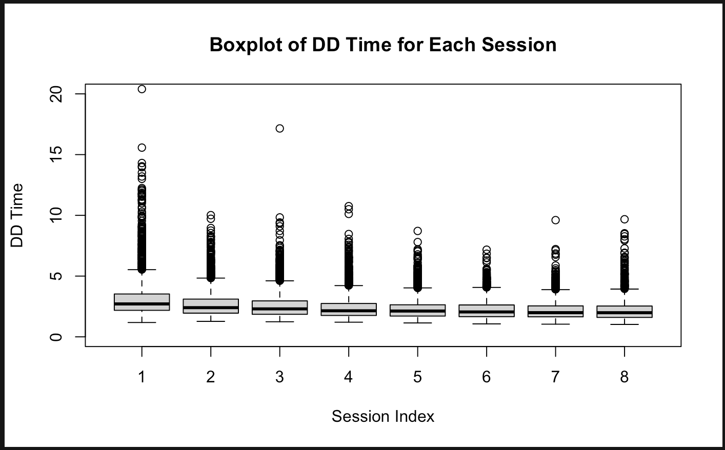
Task 1: Exploratory Data Analysis
4. Total DD (Down-Down) Time:

Slide 9
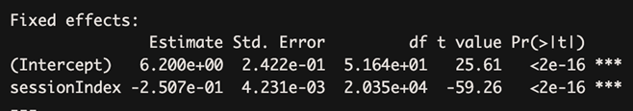
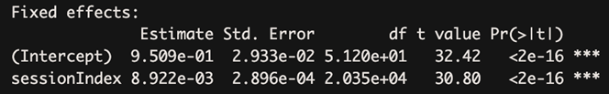
Task 2: Model Development
Model 1: Random Intercept Model
Total Time:
Total Hold Time

Slide 10

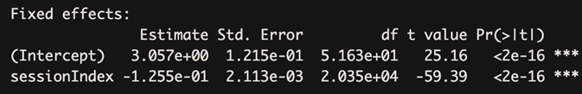
Task 2: Model Development
Total Up-Down Time:
Total Down-Down Time

Slide 11
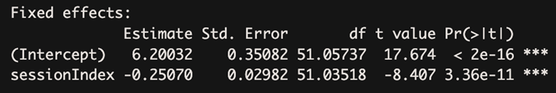
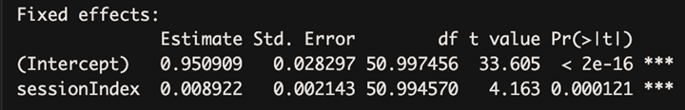
Task 2: Model Development
Model 2: Random Slope and Intercept Model
Total Time:
Total Hold Time

Slide 12
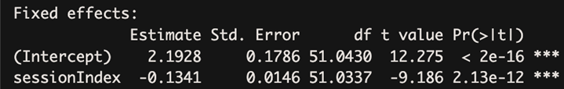
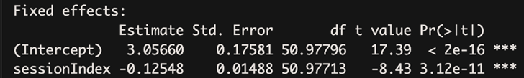
Task 2: Model Development
Total Up-Down Time:
Total Down-Down Time

Slide 13
Task 2: Model Development
ANOVA TEST:
The ANOVA test results reveal that the random slope and intercept model provides a better fit to the data compared to the random intercept model.
This conclusion is supported by p-values less than 0.05, signifying statistical significance, and lower AIC and BIC values for the former model.

Slide 14
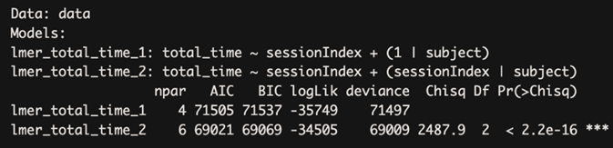
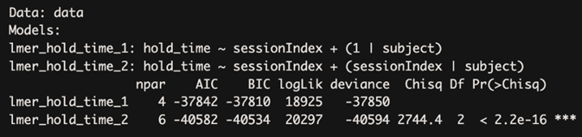
Task 2: Model Development
Total Time:
Total Hold Time

Slide 15
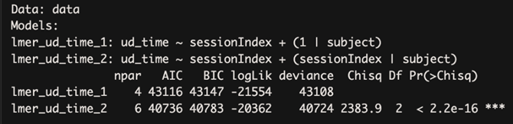
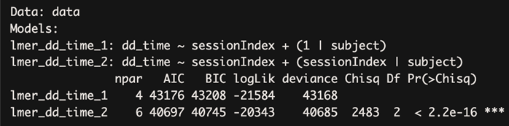
Task 2: Model Development
Total Up-Down Time:
Total Down-Down Time

Slide 16
Task 3: Post Hoc Analysis
Involved testing the assumptions of the Random Slope and Intercept model, specifically focusing on the normality of residuals and random effects.
This evaluation was carried out using qq plots and the Shapiro-Wilk test for all four response variables

Slide 17
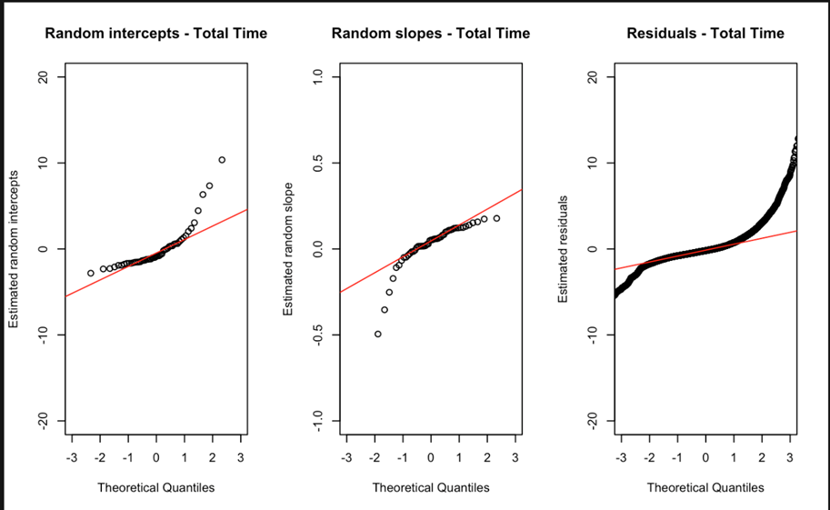
Task 3: Post Hoc Analysis
Normality test of residuals and random effects:

Slide 18
Task 3: Post Hoc Analysis
Random Intercepts: | Random Slopes: | Residuals:
W = 0.75528, p-value = 7.616e-08 The random intercepts are not normally distributed (p-value < 0.05) | W = 0.59092, p-value = 1.1e-10 The random slopes are not normally distributed (p-value < 0.05) | W = 0.74384, p-value < 2.2e-16 The residuals are not normally distributed (p-value < 0.05)

Slide 19
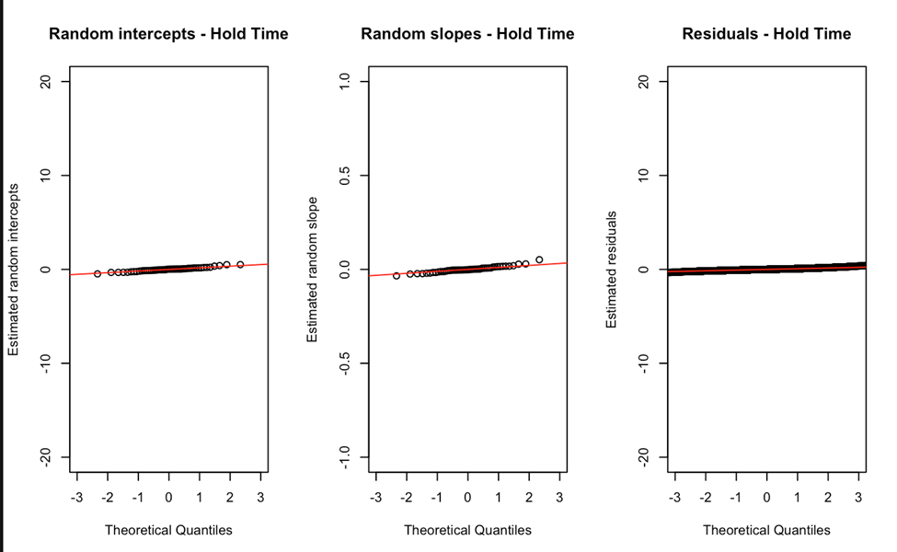
Task 3: Post Hoc Analysis

Slide 20
Task 3: Post Hoc Analysis
Random Intercepts: | Random Slopes: | Residuals:
W = 0.97661, p-value = 0.4063 The random intercepts are normally distributed (p-value >= 0.05) | W = 0.96422, p-value = 0.1262 The random slopes are normally distributed (p-value >= 0.05) | W = 0.96422, p-value = 0.1262 The random slopes are normally distributed (p-value >= 0.05)

Slide 21
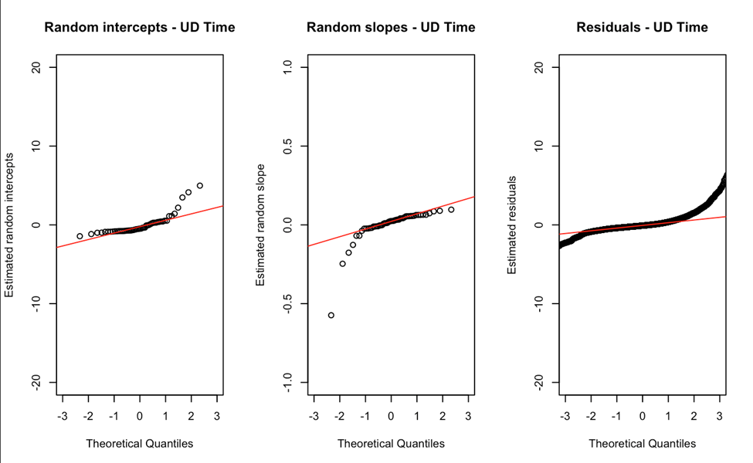
Task 3: Post Hoc Analysis

Slide 22
Task 3: Post Hoc Analysis
Random Intercepts: | Random Slopes: | Residuals:
W = 0.73207, p-value = 2.616e-08 The random intercepts are not normally distributed (p-value < 0.05) | W = 0.61024, p-value = 2.141e-10 The random slopes are not normally distributed (p-value < 0.05) | W = 0.7767, p-value < 2.2e-16 The residuals are not normally distributed (p-value < 0.05)

Slide 23
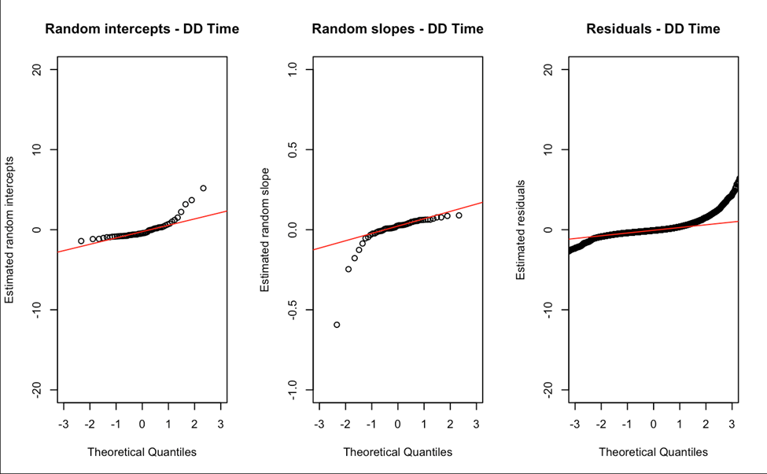
Task 3: Post Hoc Analysis

Slide 24
Task 3: Post Hoc Analysis
Random Intercepts: | Random Slopes: | Residuals:
W = 0.75405, p-value = 7.187e-08 The random intercepts are not normally distributed (p-value < 0.05) | W = 0.58844, p-value = 1.011e-10 The random slopes are not normally distributed (p-value < 0.05) | W = 0.5928, p-value < 2.2e-16 The residuals are not normally distributed (p-value < 0.05)

Slide 25
Task 3: Post Hoc Analysis
Pairwise Comparison:
Pairwise comparisons were conducted to compare marginal means for total typing time, total key hold time, total key up down time, and total key down down time across different session indices.

Slide 26
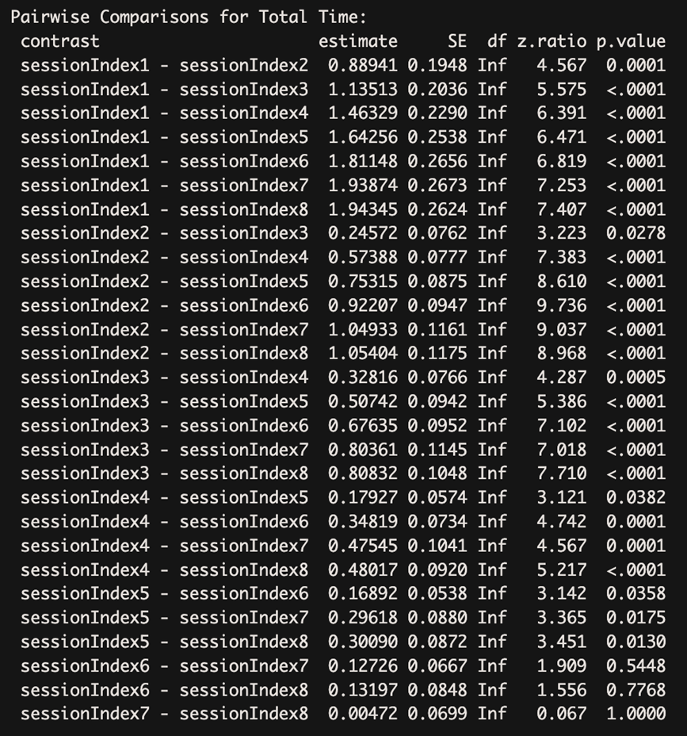
Task 3: Post Hoc Analysis

Slide 27
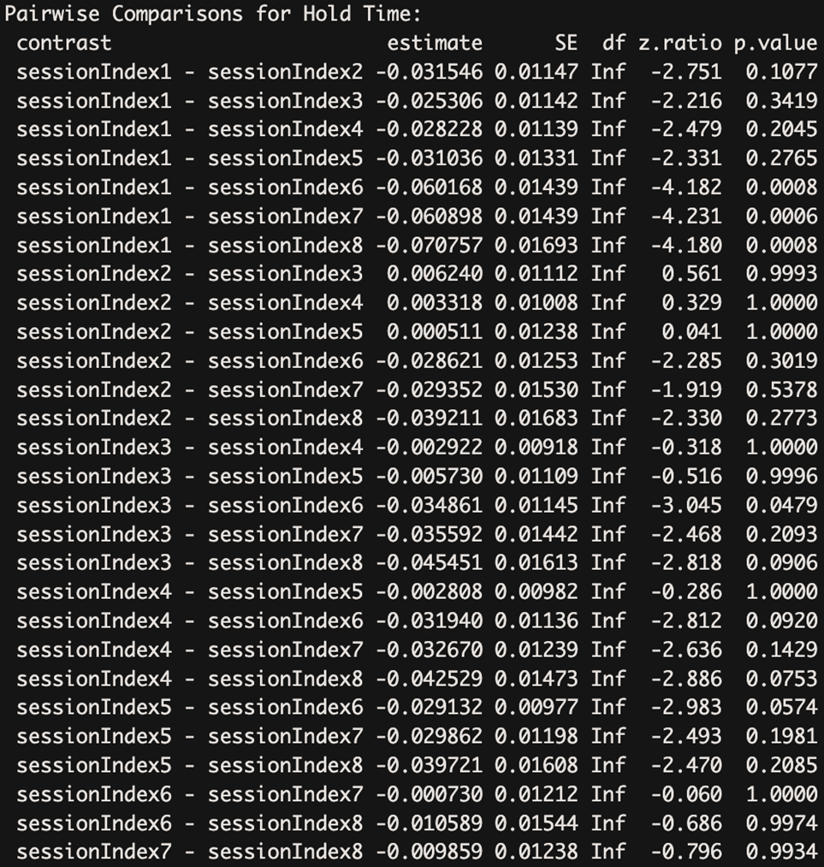
Task 3: Post Hoc Analysis

Slide 28
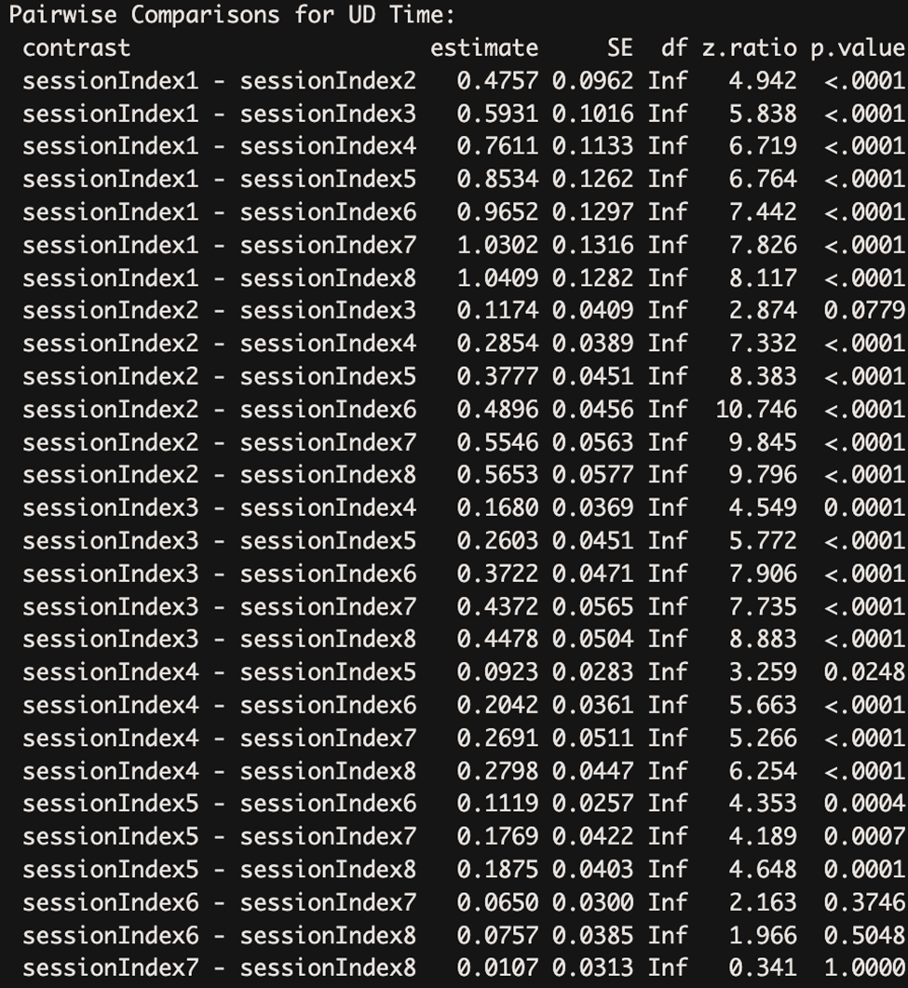
Task 3: Post Hoc Analysis

Slide 29
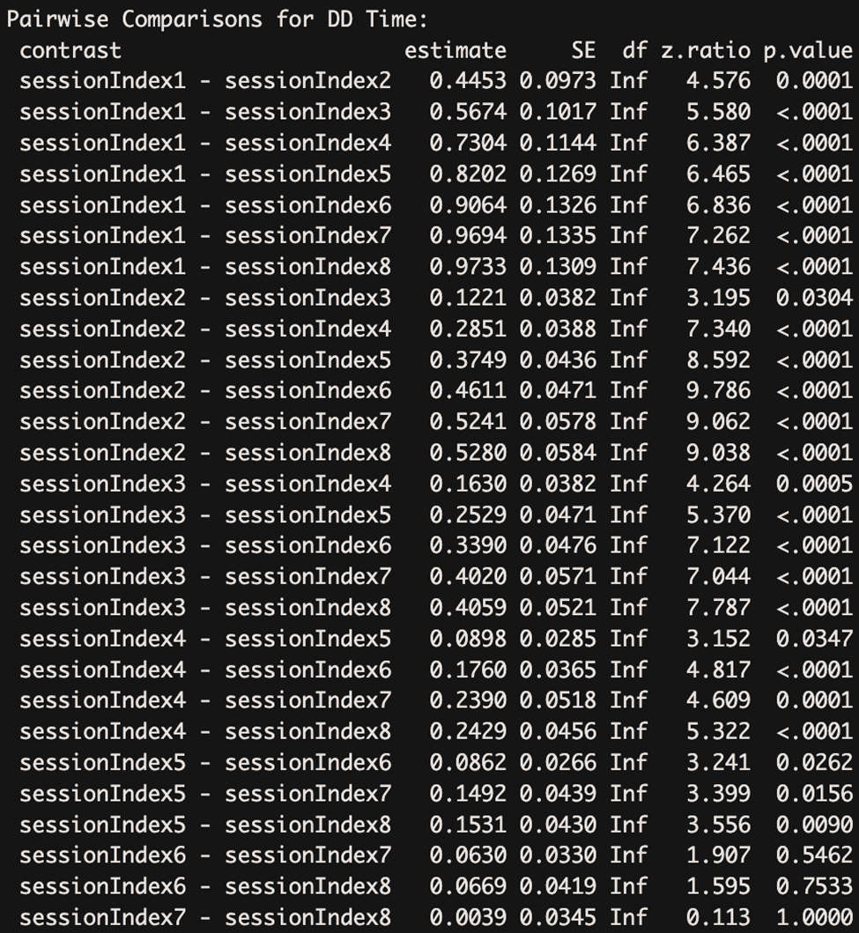
Task 3: Post Hoc Analysis

Slide 30
Task 4: Quantile Regression
Quantile regression provides a more thorough understanding of the relationship between variables by focusing on predicting multiple percentiles (quantiles) of the response variable rather than just the average response, as classical regression does.
Implemented quantile regression by first creating a repetitions column using the formula (sessionIndex-1)*50 + rep(sessionIndex-1)*50 + rep, representing the number of times a subject typed the password

Slide 31
Task 4: Quantile Regression
The model was defined using the formula total_time ˜ns(repetitions, df = 3)total_time ˜ns(repetitions, df = 3), and the non-linear quantile regression model was fitted using the \text{rqss} function with the specified quantile levels of 0.025, 0.25, 0.5, 0.75, and 0.975.

Slide 32
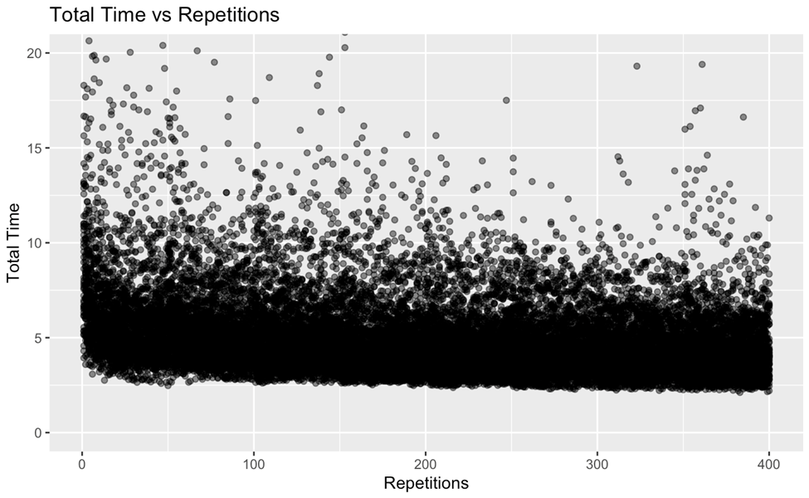
Task 4: Quantile Regression

Slide 33
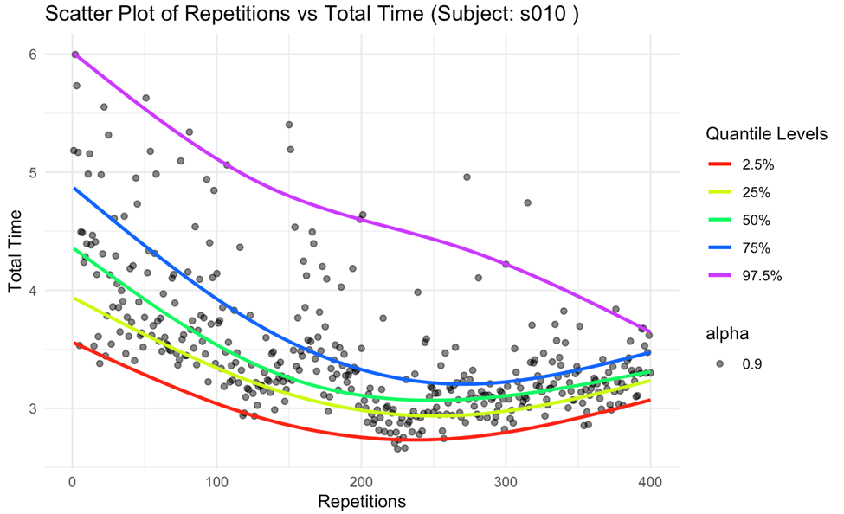
Task 4: Quantile Regression

Slide 34
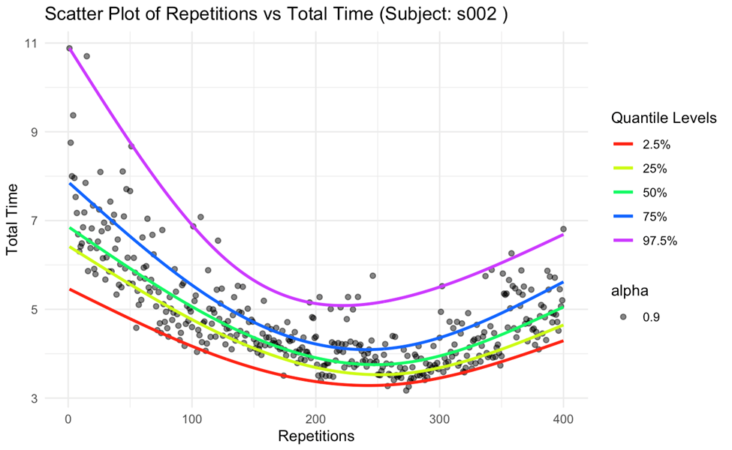
Task 4: Quantile Regression

Slide 35
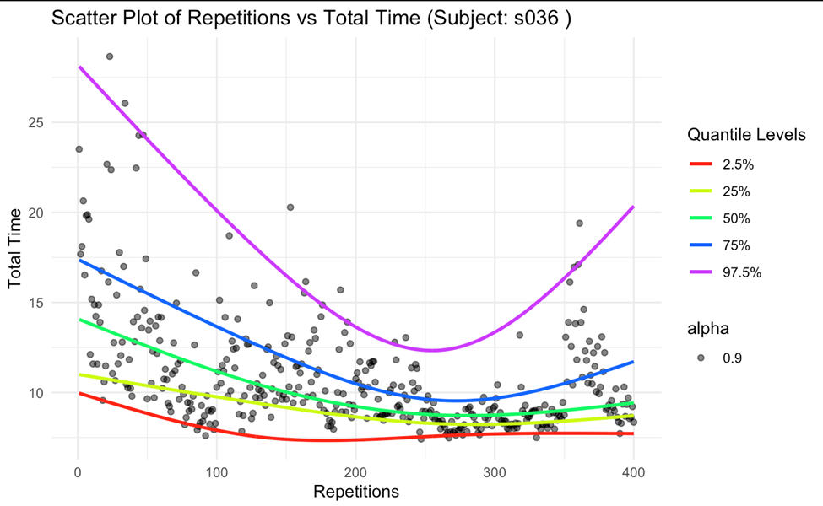
Task 4: Quantile Regression

Slide 36
Task 4: Quantile Regression
Prediction for Subject s010
Quantile_level | 2.5 | 25 | 50
Prediction | 2.7424 | 2.964035 | 3.0658
Prediction for Subject s002
Quantile_level | 2.5 | 25 | 50
Prediction | 3.3584 | 3.662085 | 3.8851
Prediction for Subject s036
Quantile_level | 2.5 | 25 | 50
Prediction | 7.1906 | 8.605796 | 9.0736

Slide 37
Conclusion
Typing dynamics, encompassing key holding and interaction times, were identified as crucial metrics for understanding password entry behavior.
Through extensive analysis, we observed distinct patterns in the temporal evolution of typing dynamics. Interaction time consistently decreased, while holding time exhibited varied trends across different individuals.
To comprehensively capture the nuances of typing behavior, we opted for total typing time as the primary measure. This allowed us to account for the complex interplay between holding time, key up-down time, and key down-down time.

Slide 38
Conclusion
While Linear Mixed Effects Random models indicated temporal changes, we recognized that model assumptions aligned more effectively with hold time as the response variable. This insight is vital for accurate model selection.
Further validation through pairwise comparisons emphasized significant differences in typing dynamics across various session times, reinforcing the notion that password typing behavior undergoes substantial variations.

Slide 39
References
Kevin S. Killourhy, Roy A. Maxion (2009) Comparing Anomaly-Detection Algorithms for Keystroke Dynamics (cmu.edu)
Marvin. (2020, June 30). Probabilitic_flood_forecast#linear-quantile-regression. Retrieved from https://github.com/marvinmin/Probabilitic_flood_forecast#linear-quantile-regression
Roger Koenker and Kevin F. Hallock (2001). Quantile Regression (uiuc.edu)
Liping Huang, Wenying Zhu, Christopher P Saunders, James N MacLeod, Mai Zhou, Arnold J Stromberg & Arne C Bathke, (2008). A novel application of quantile regression for identification of biomarkers exemplified by equine cartilage microarray data | BMC Bioinformatics (springer.com)
Nikolay Oskolkov (2020). How Linear Mixed Model Works. And how to understand LMM through… | by Nikolay Oskolkov | Towards Data Science
Rebecca Pillinger, Random intercept models | Centre for Multilevel Modelling | University of Bristol
Brunton-Smith. Multilevel Models: Random Intercept Models | Ian Brunton-Smith - YouTube
Corey S. Sparks, PhD. (2018). RPubs - DEM 7473 - Week 3: Basic Hierarchical Models - Random Intercepts and Slopes
Analytics Vidhya - Gurchetan Singh. (2023). ANOVA: Complete guide to Statistical Analysis & Applications (analyticsvidhya.com)
Sachin Date. Introduction To The Quantile Regression Model – Time Series Analysis, Regression, and Forecasting (timeseriesreasoning.com)

Slide 40
Thank You!!!.

